Slide 1
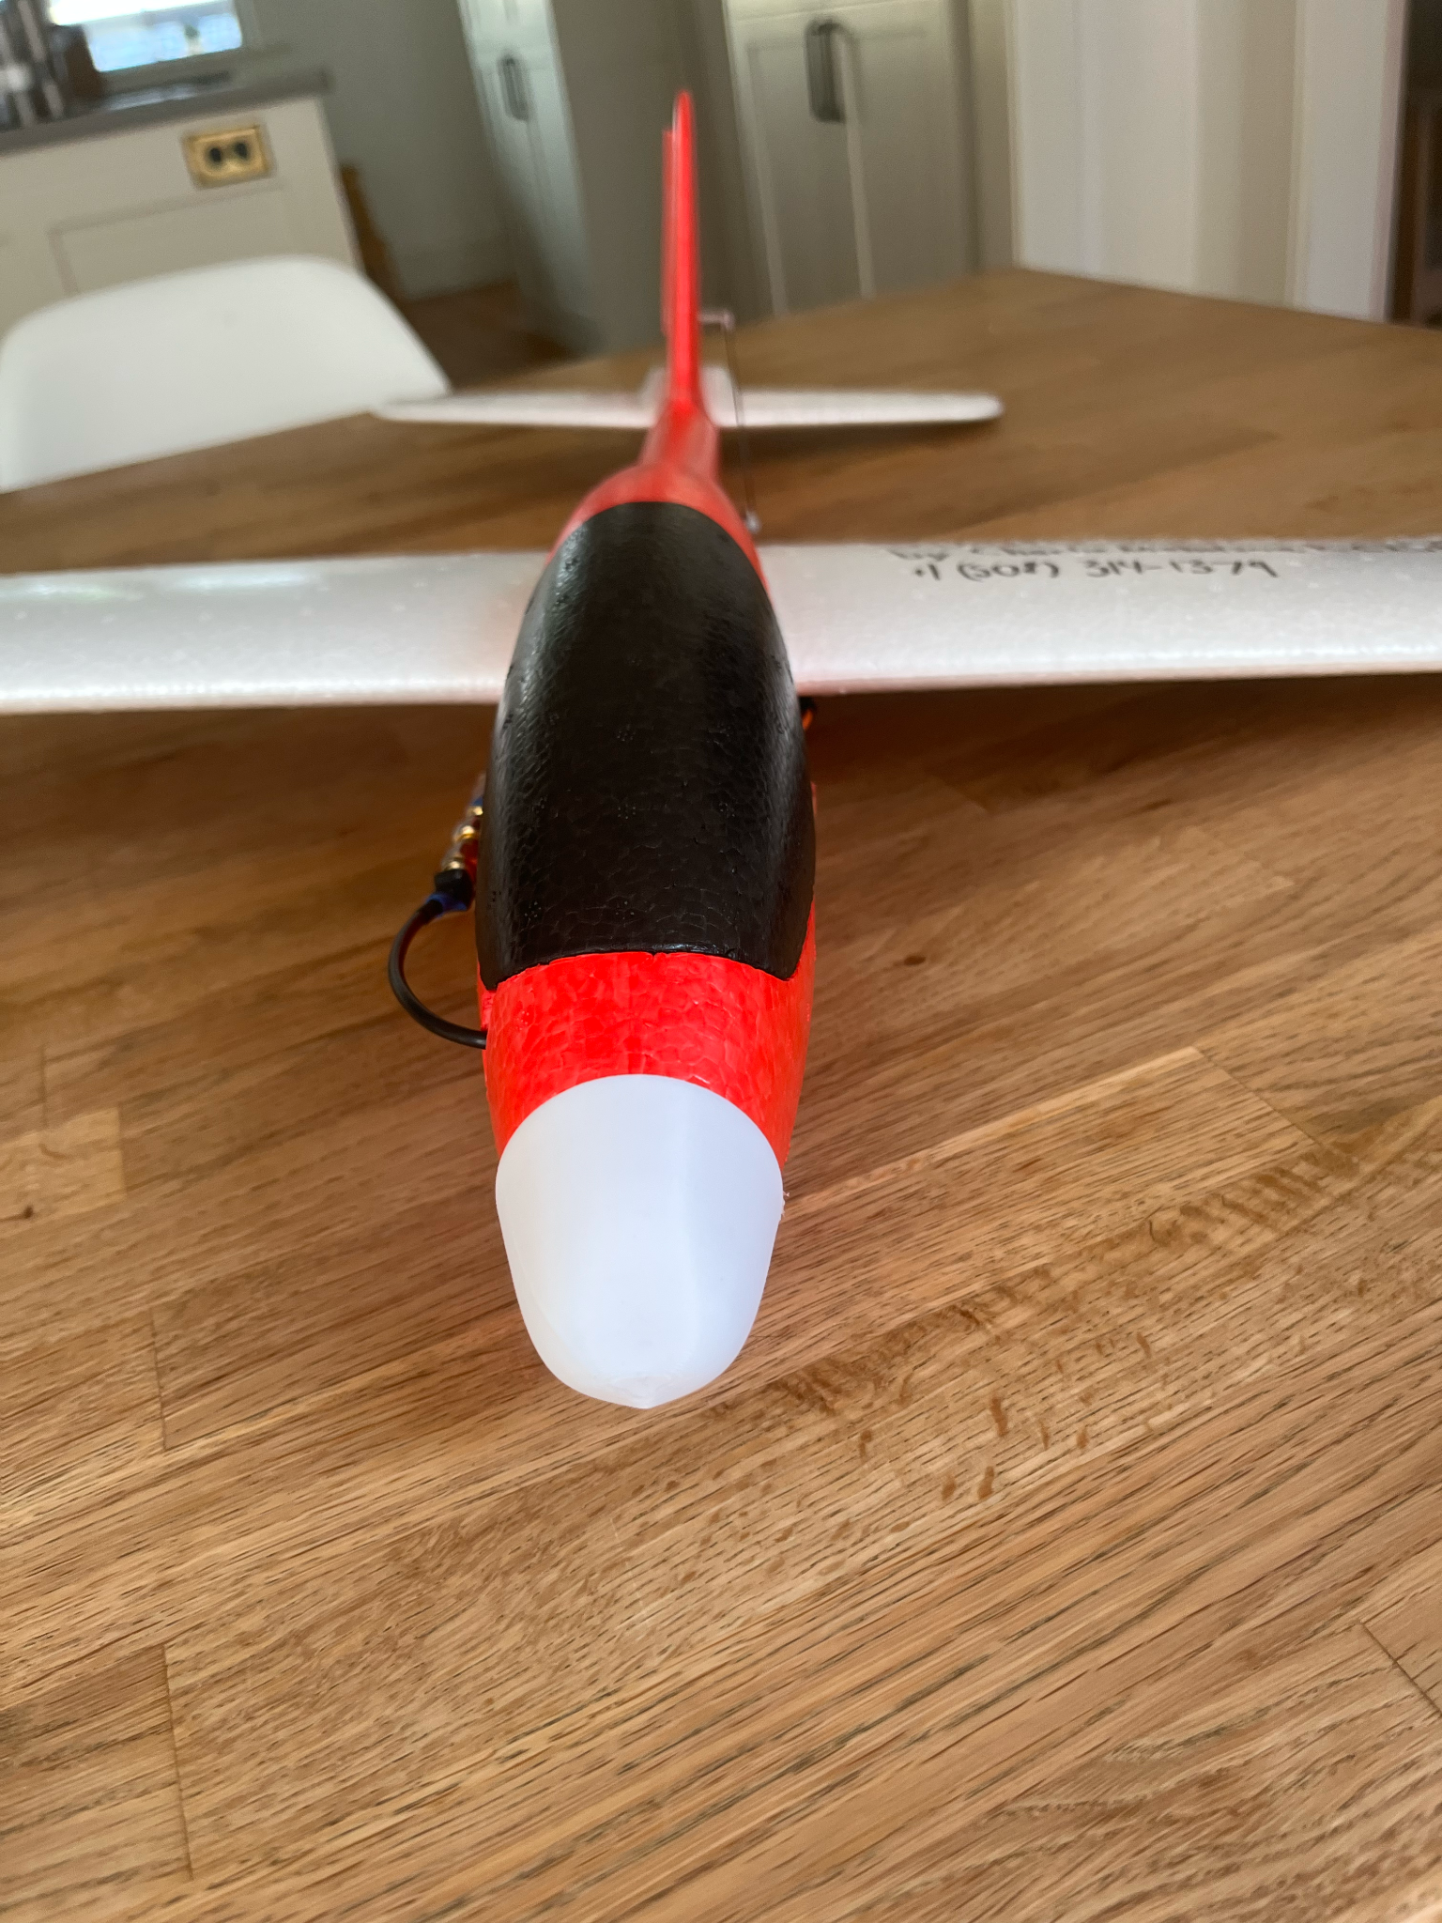
StratoSoar MK2
The High Altitude Glider
By Charlie Nicholson, KC1SFR

Slide 2
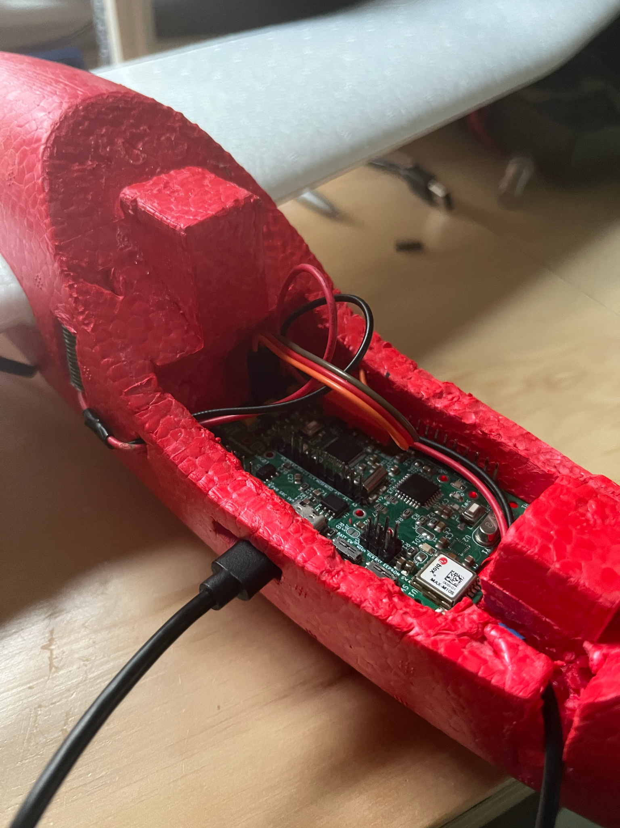
The Problem
Radiosondes pollute everyday
They drop circuit boards, batteries and foam

Slide 3
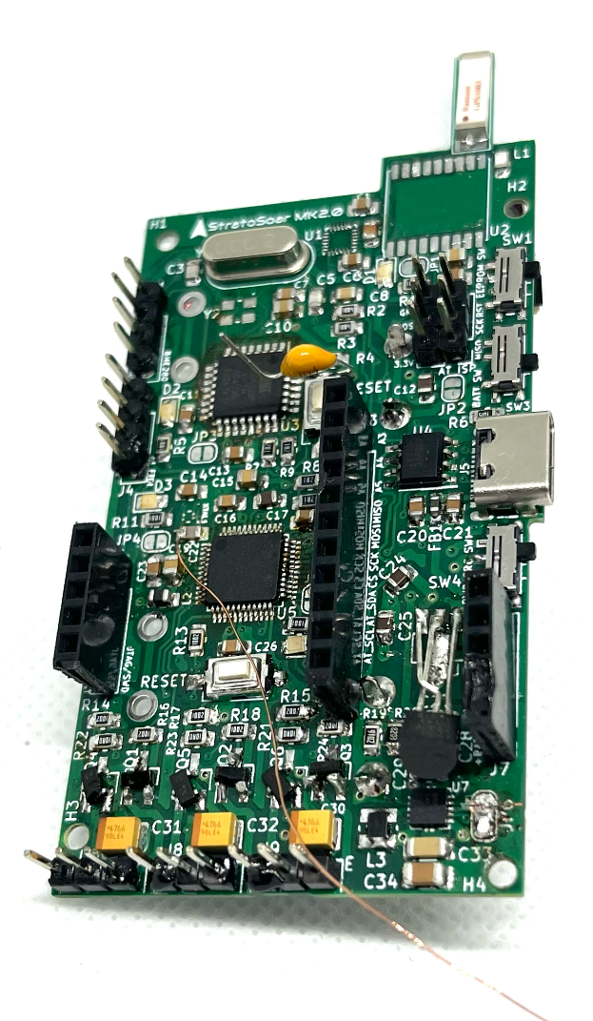
The Solution
A glider that can steer home for reuse
Glider has same sensors that a radiosonde would have + more
First revision of the circuit board.

Slide 4
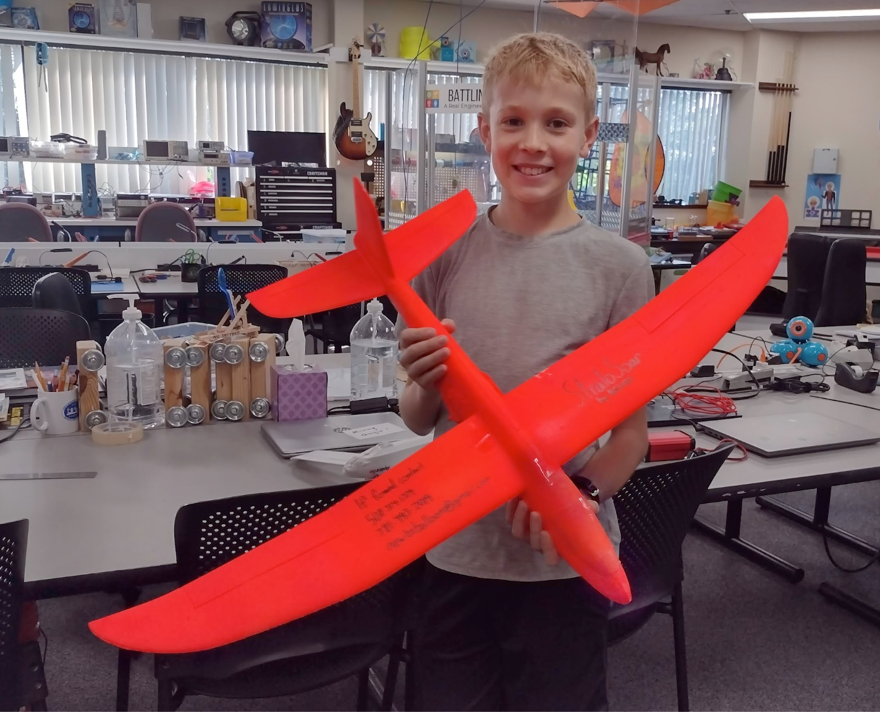
Past Work
Tried last year with StratoSoar MK1
Didn’t achieve autonomy or correct tracking

Slide 5
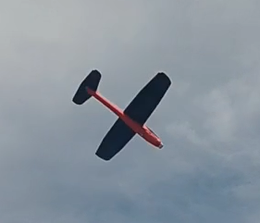
What I Did
Autonomous glider
Custom flight computer PCB
Launch from 3,000 feet
Tiny4FSK tracking system

Slide 6
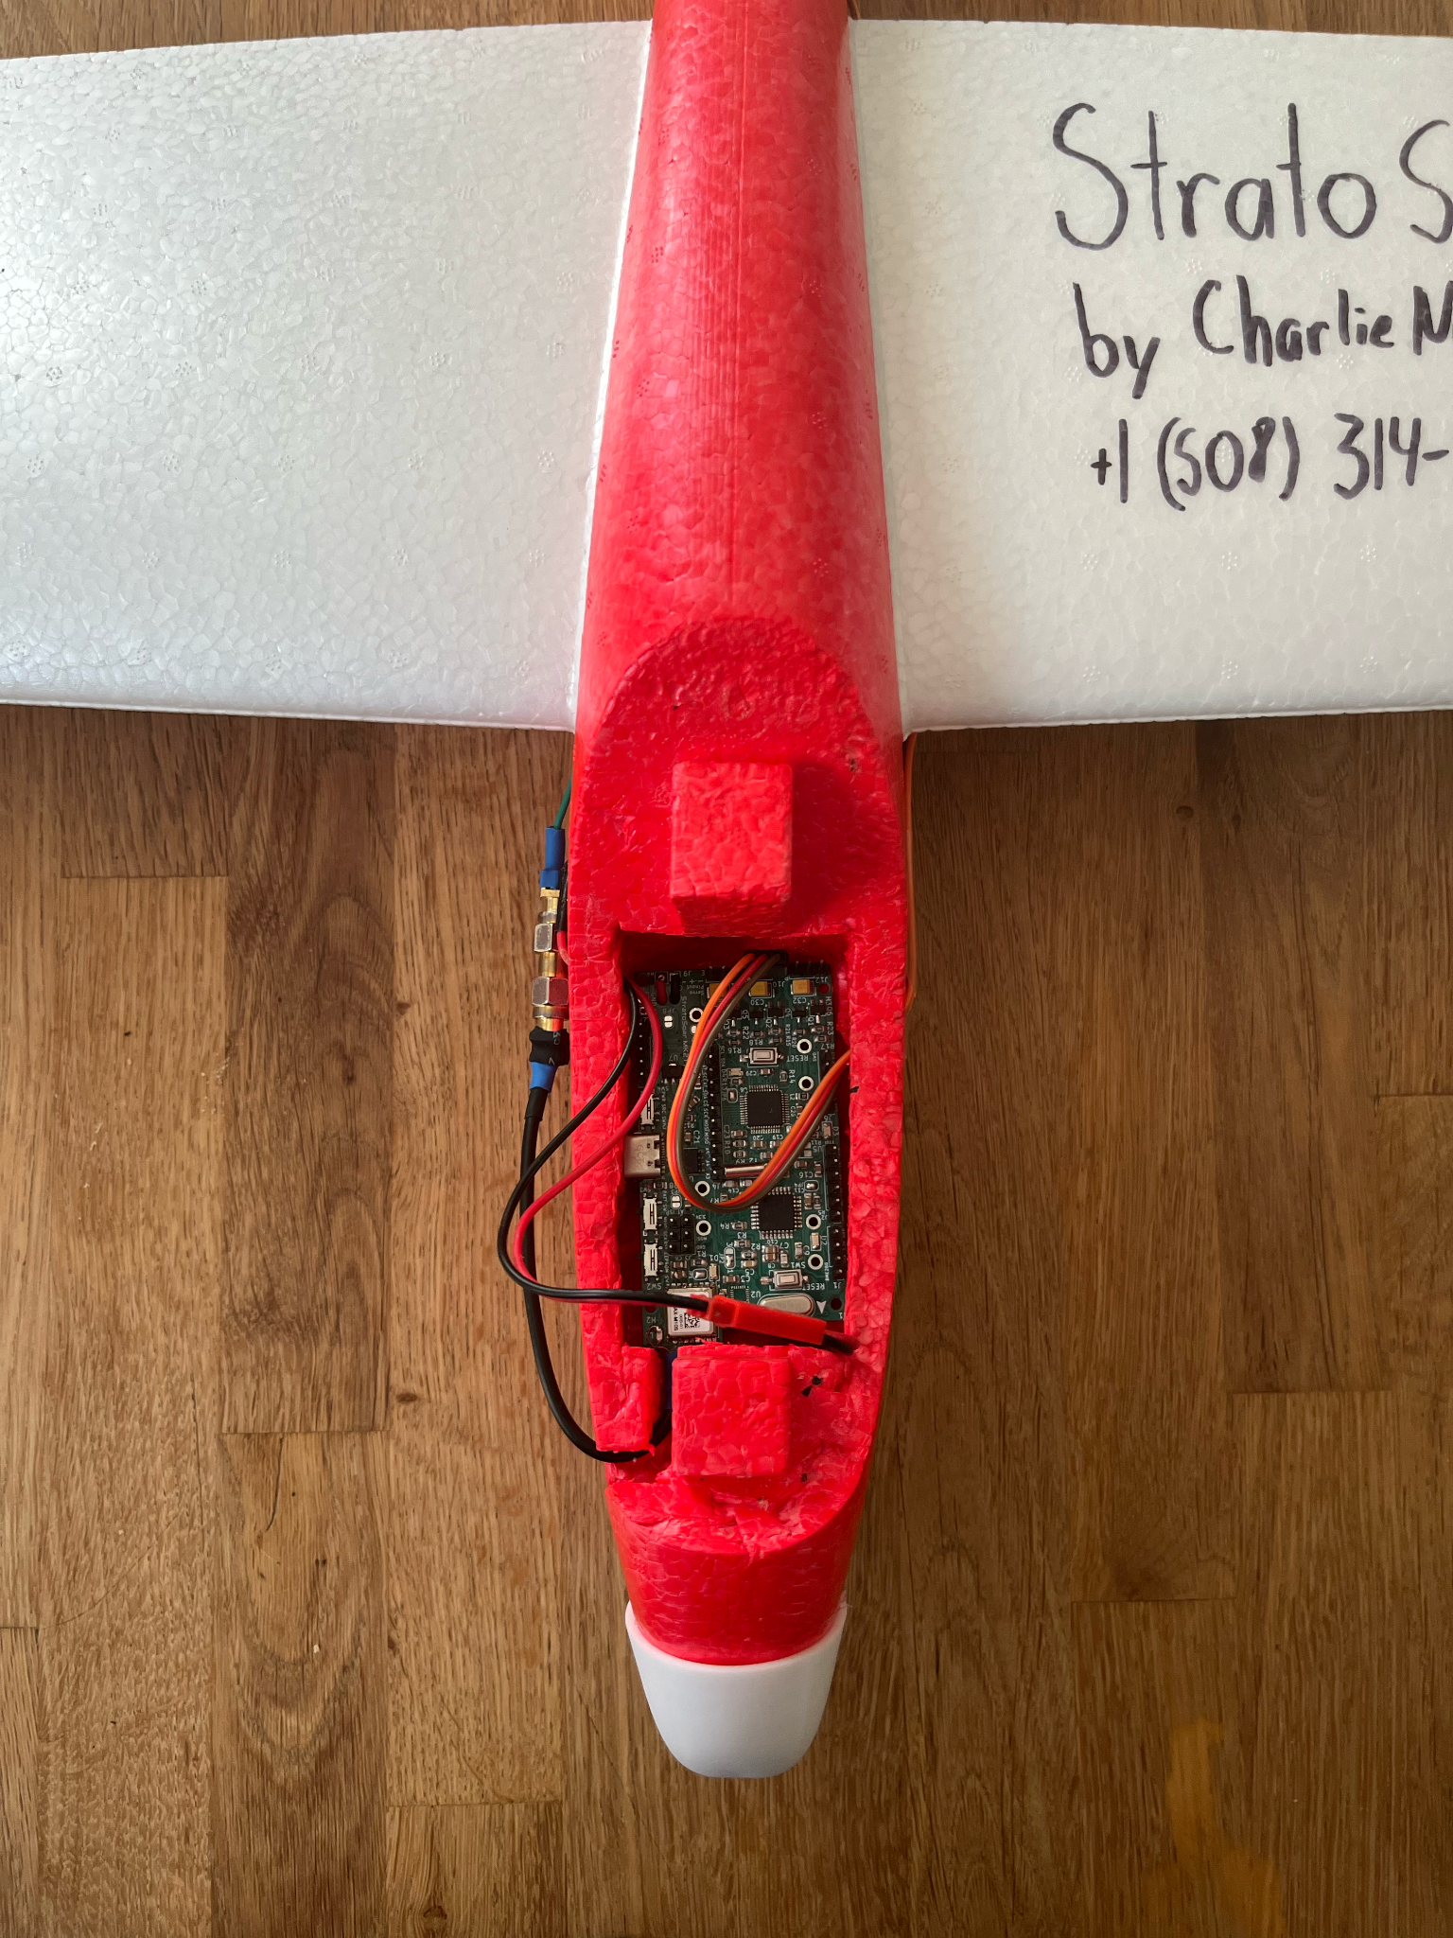
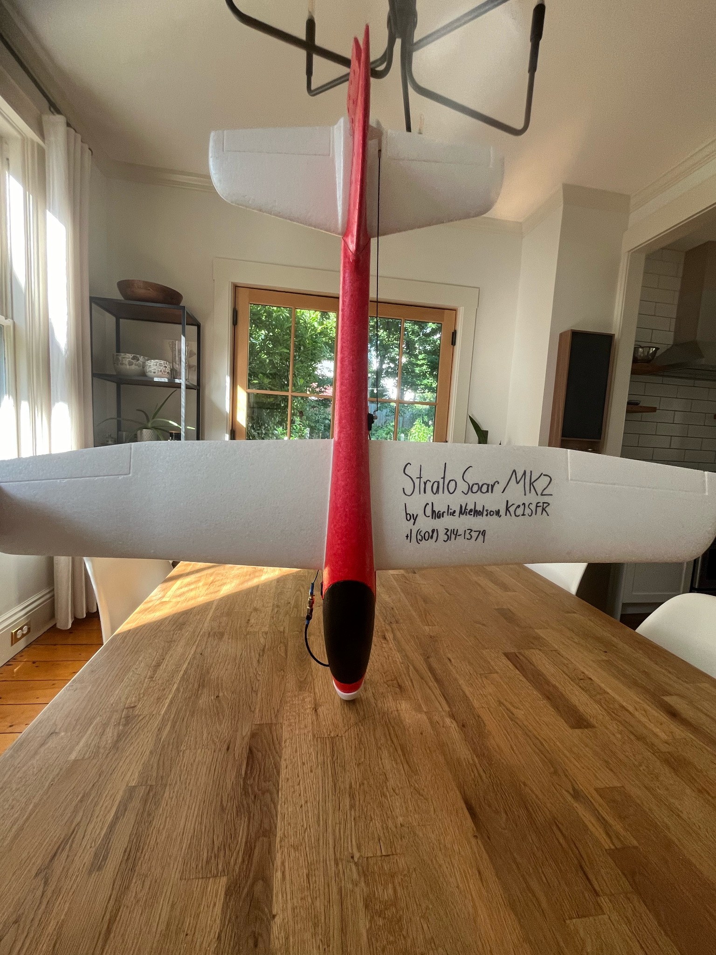
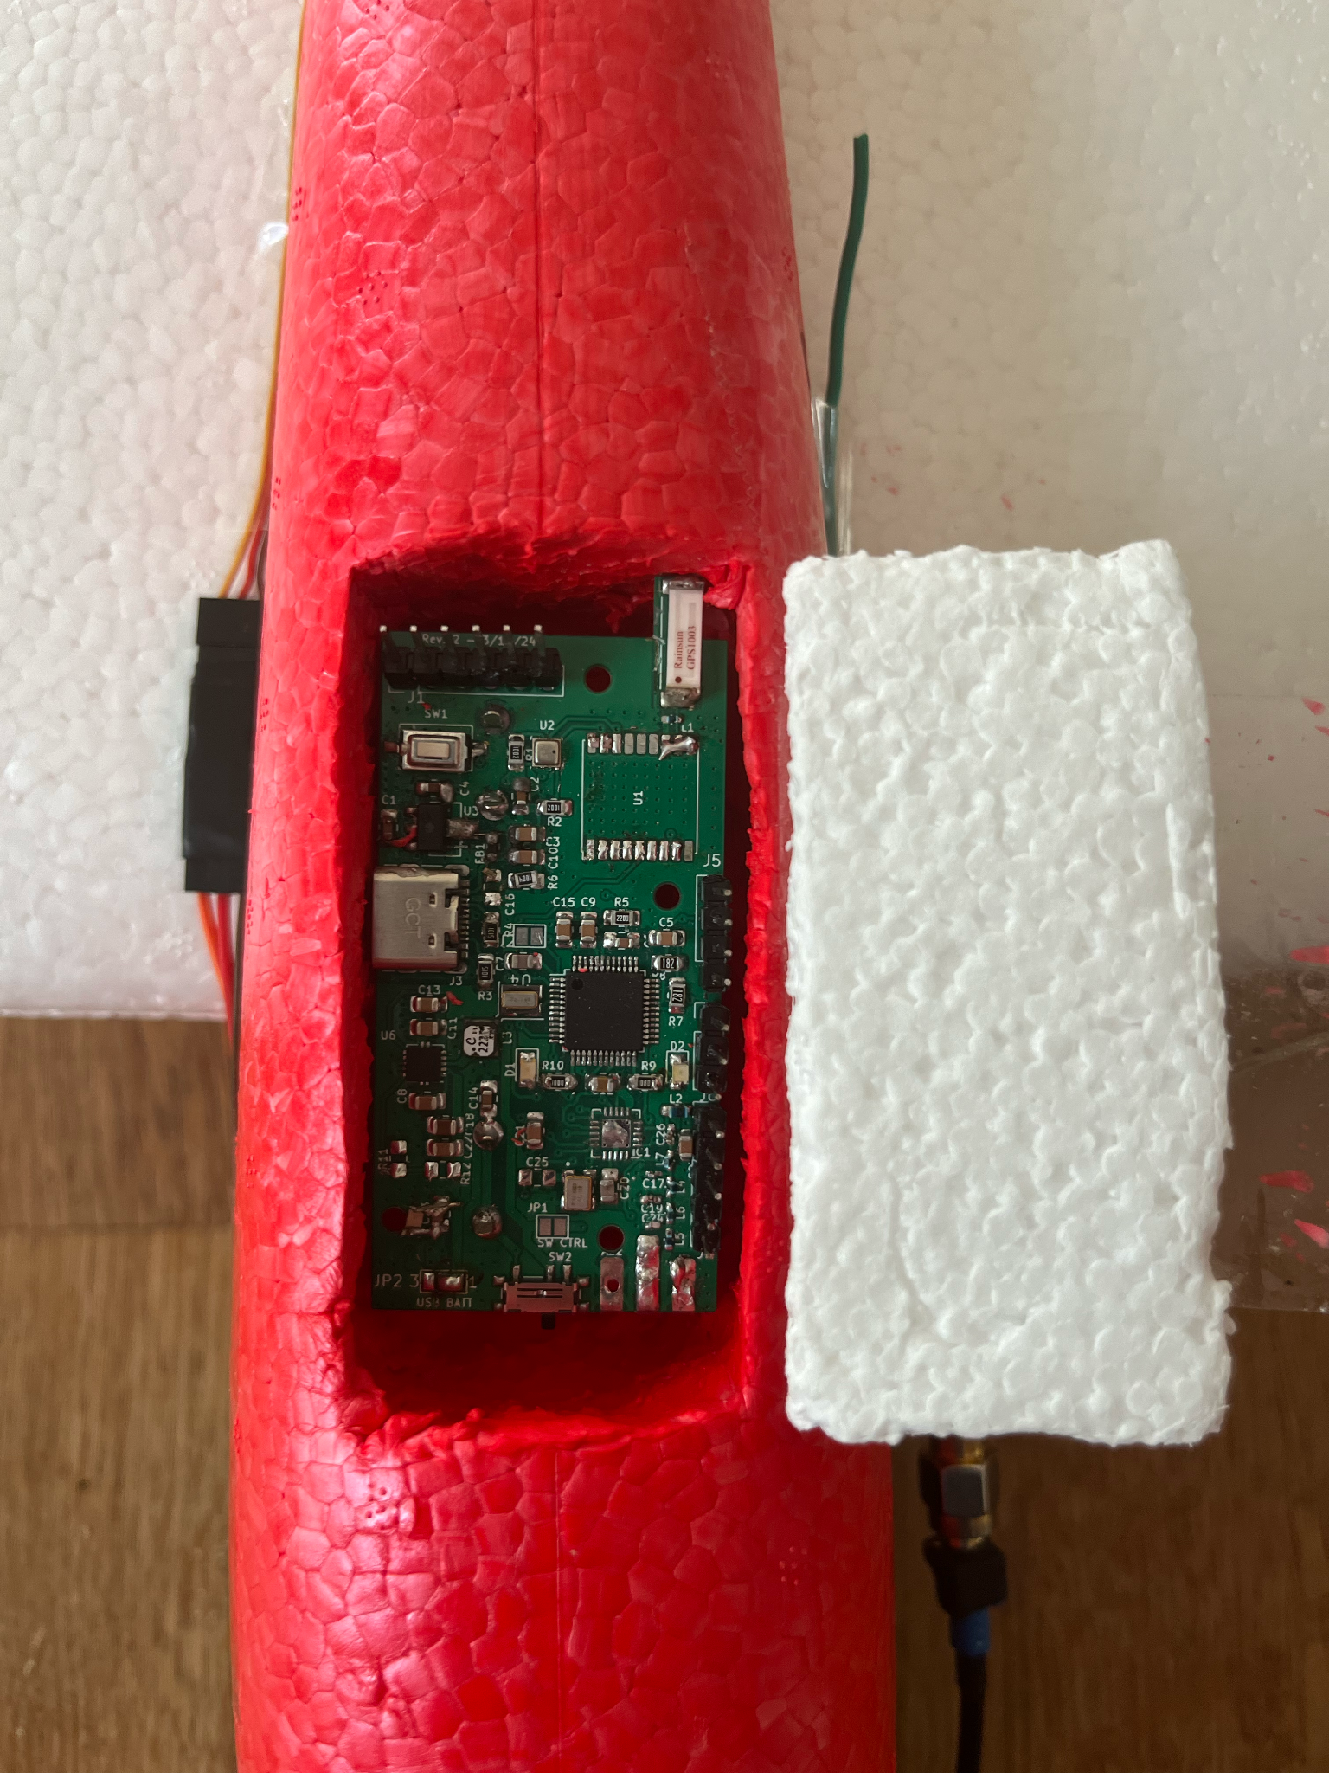
The Glider
Store bought foam glider
Cockpit rigged to hold custom PCB
Rudder modified for servo
Bay for tracker

Slide 7
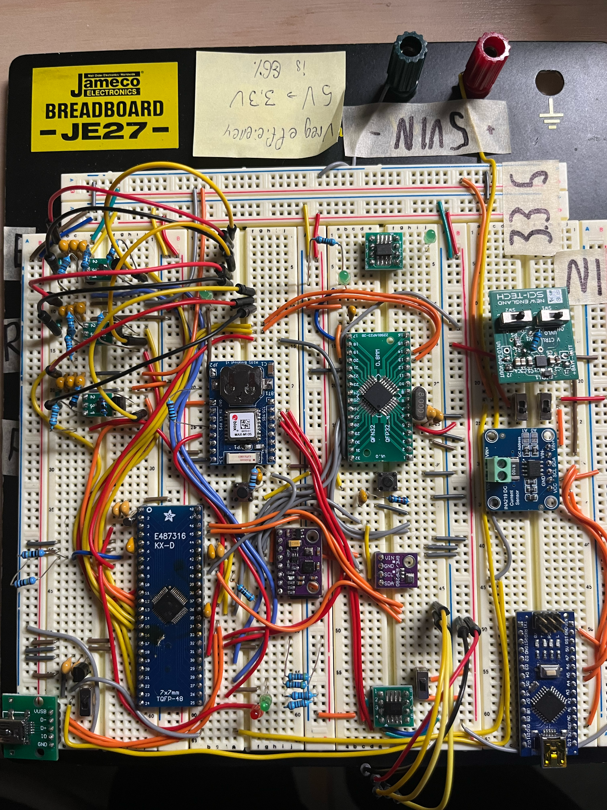
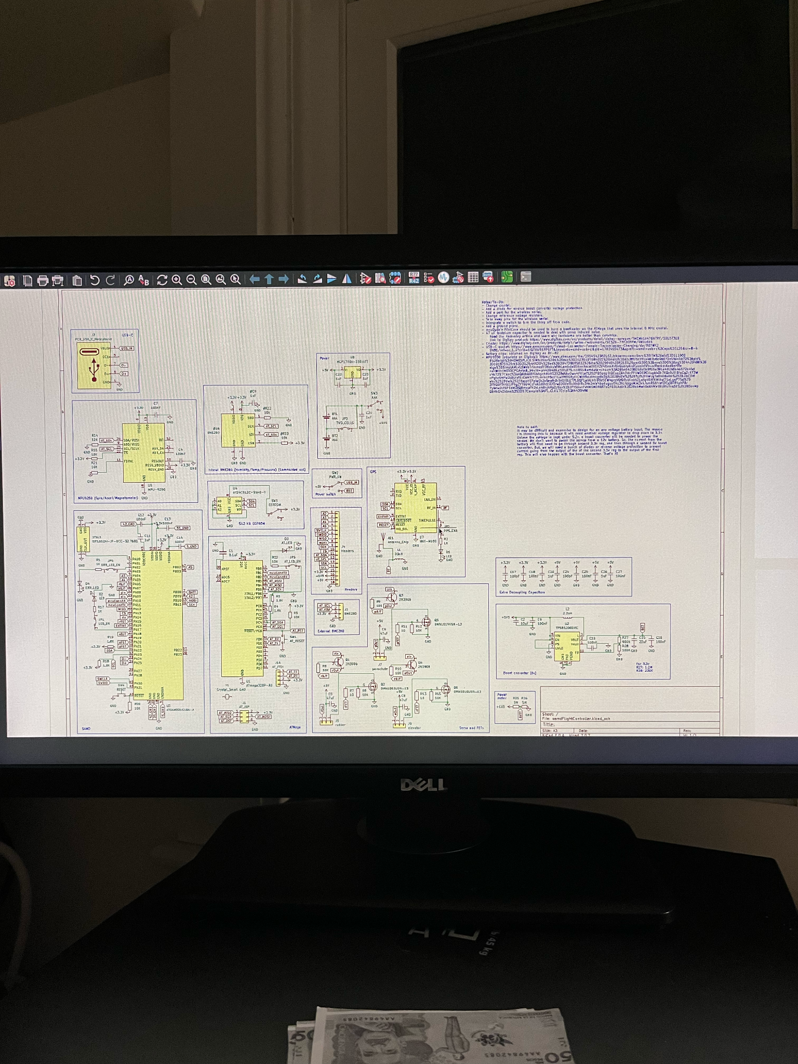
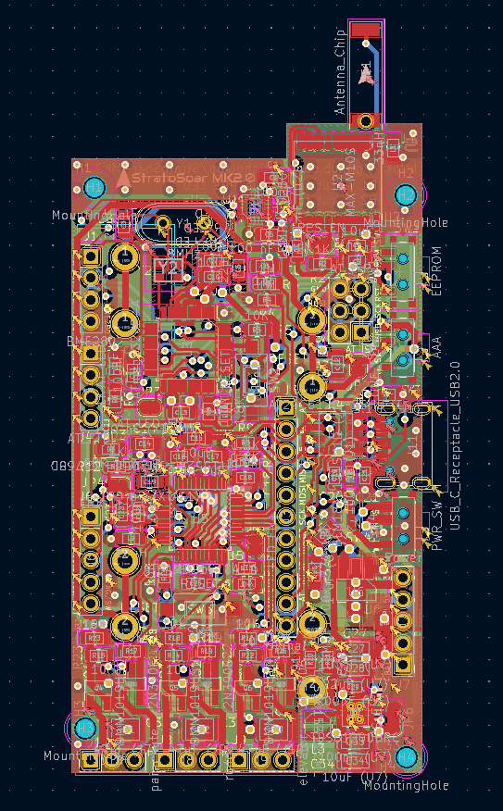
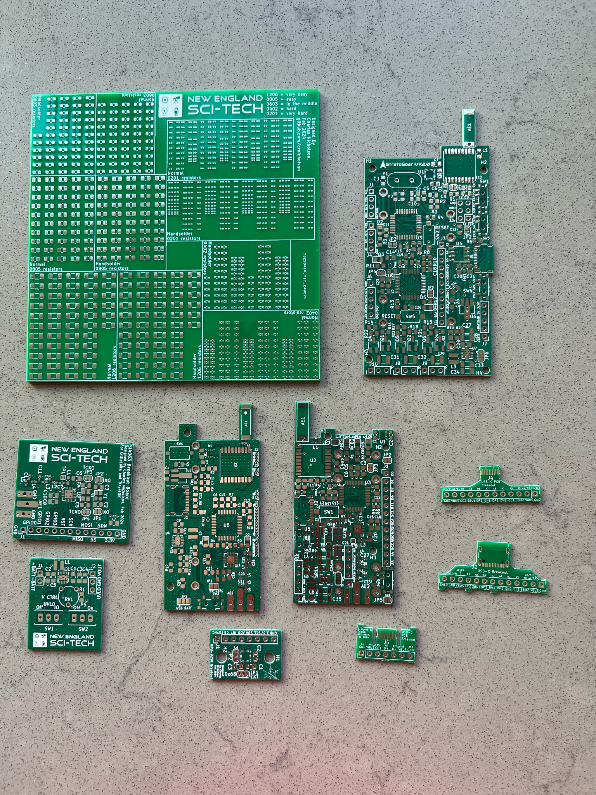
Electronics
2.
1.
Custom 4-layer PCB
150+ components
9 breakout boards
RF + power electronics
3 revisions
4.
3.

Slide 8

Code + Function
Arduino C++
IMU input w/ Kalman filter
PID algorithm
Low power modes

Slide 9
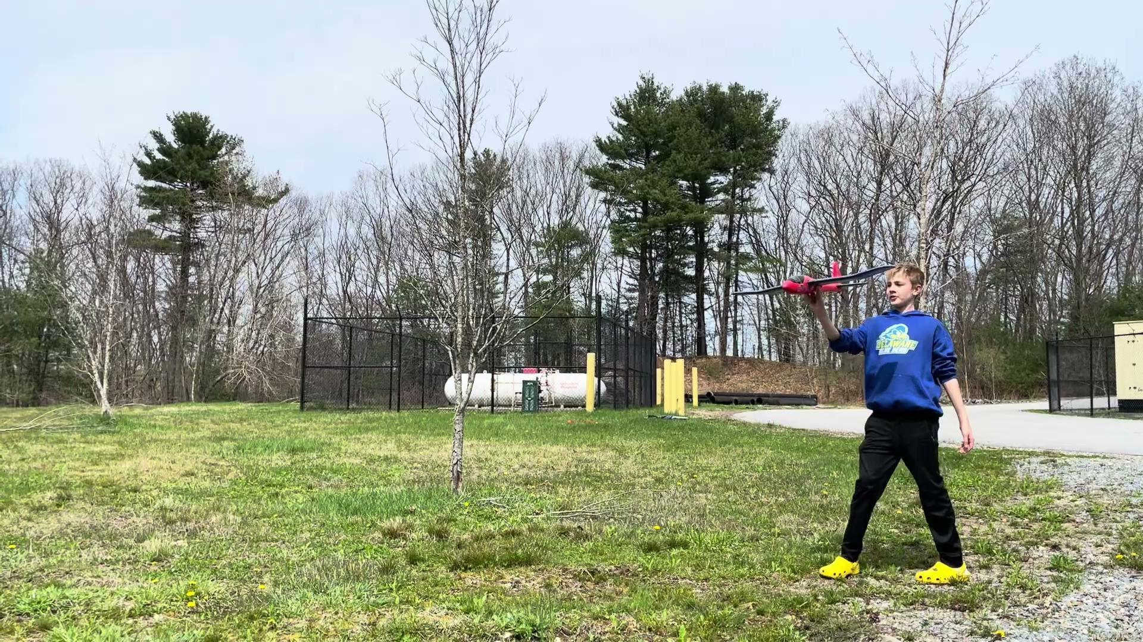
Results
Glider will be flown after Xpo
Field testing shows success
Glider can navigate autonomously to correct coordinates
10 hours battery life on 10 gram battery

Slide 10
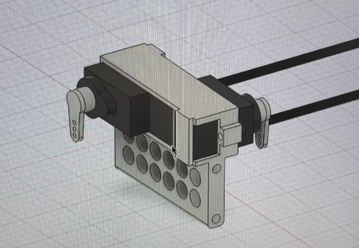
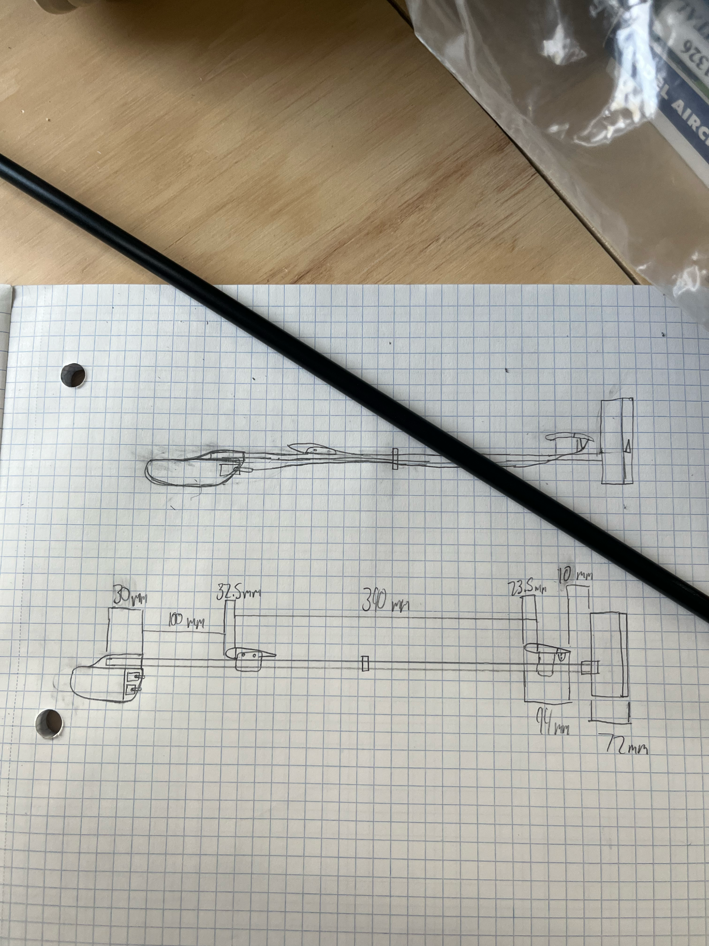
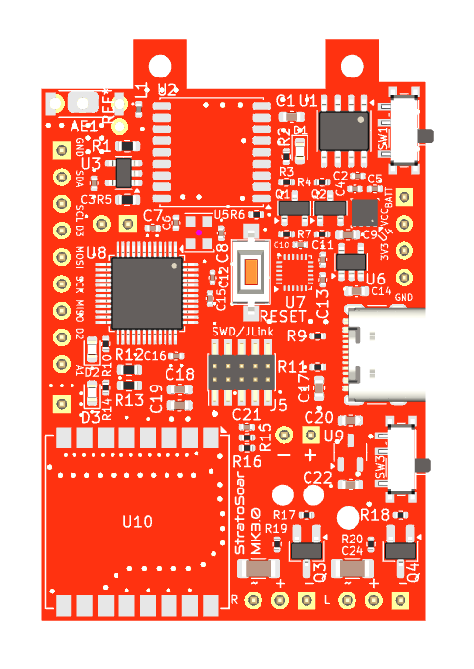
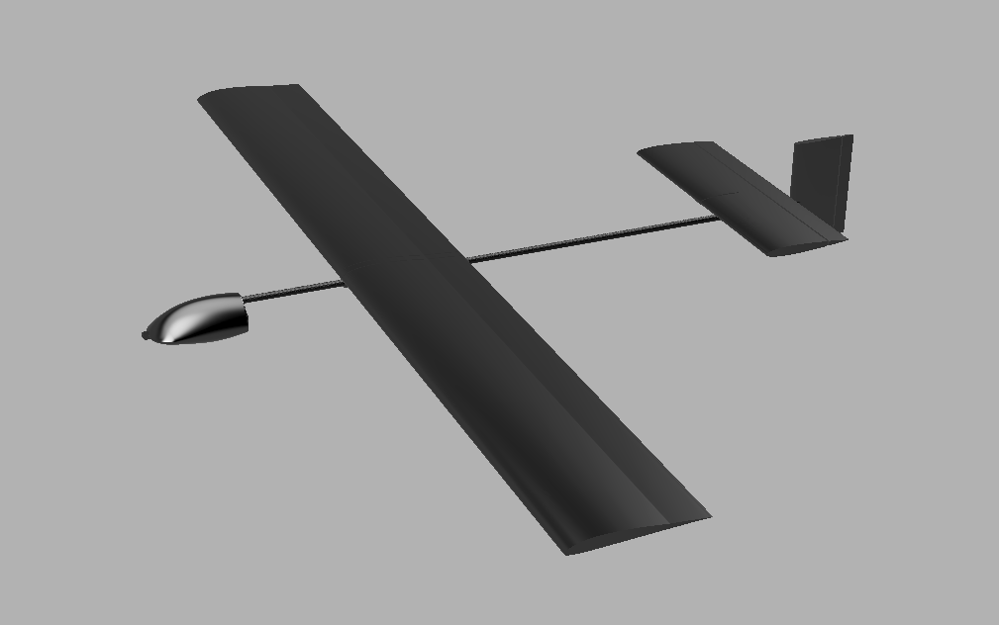
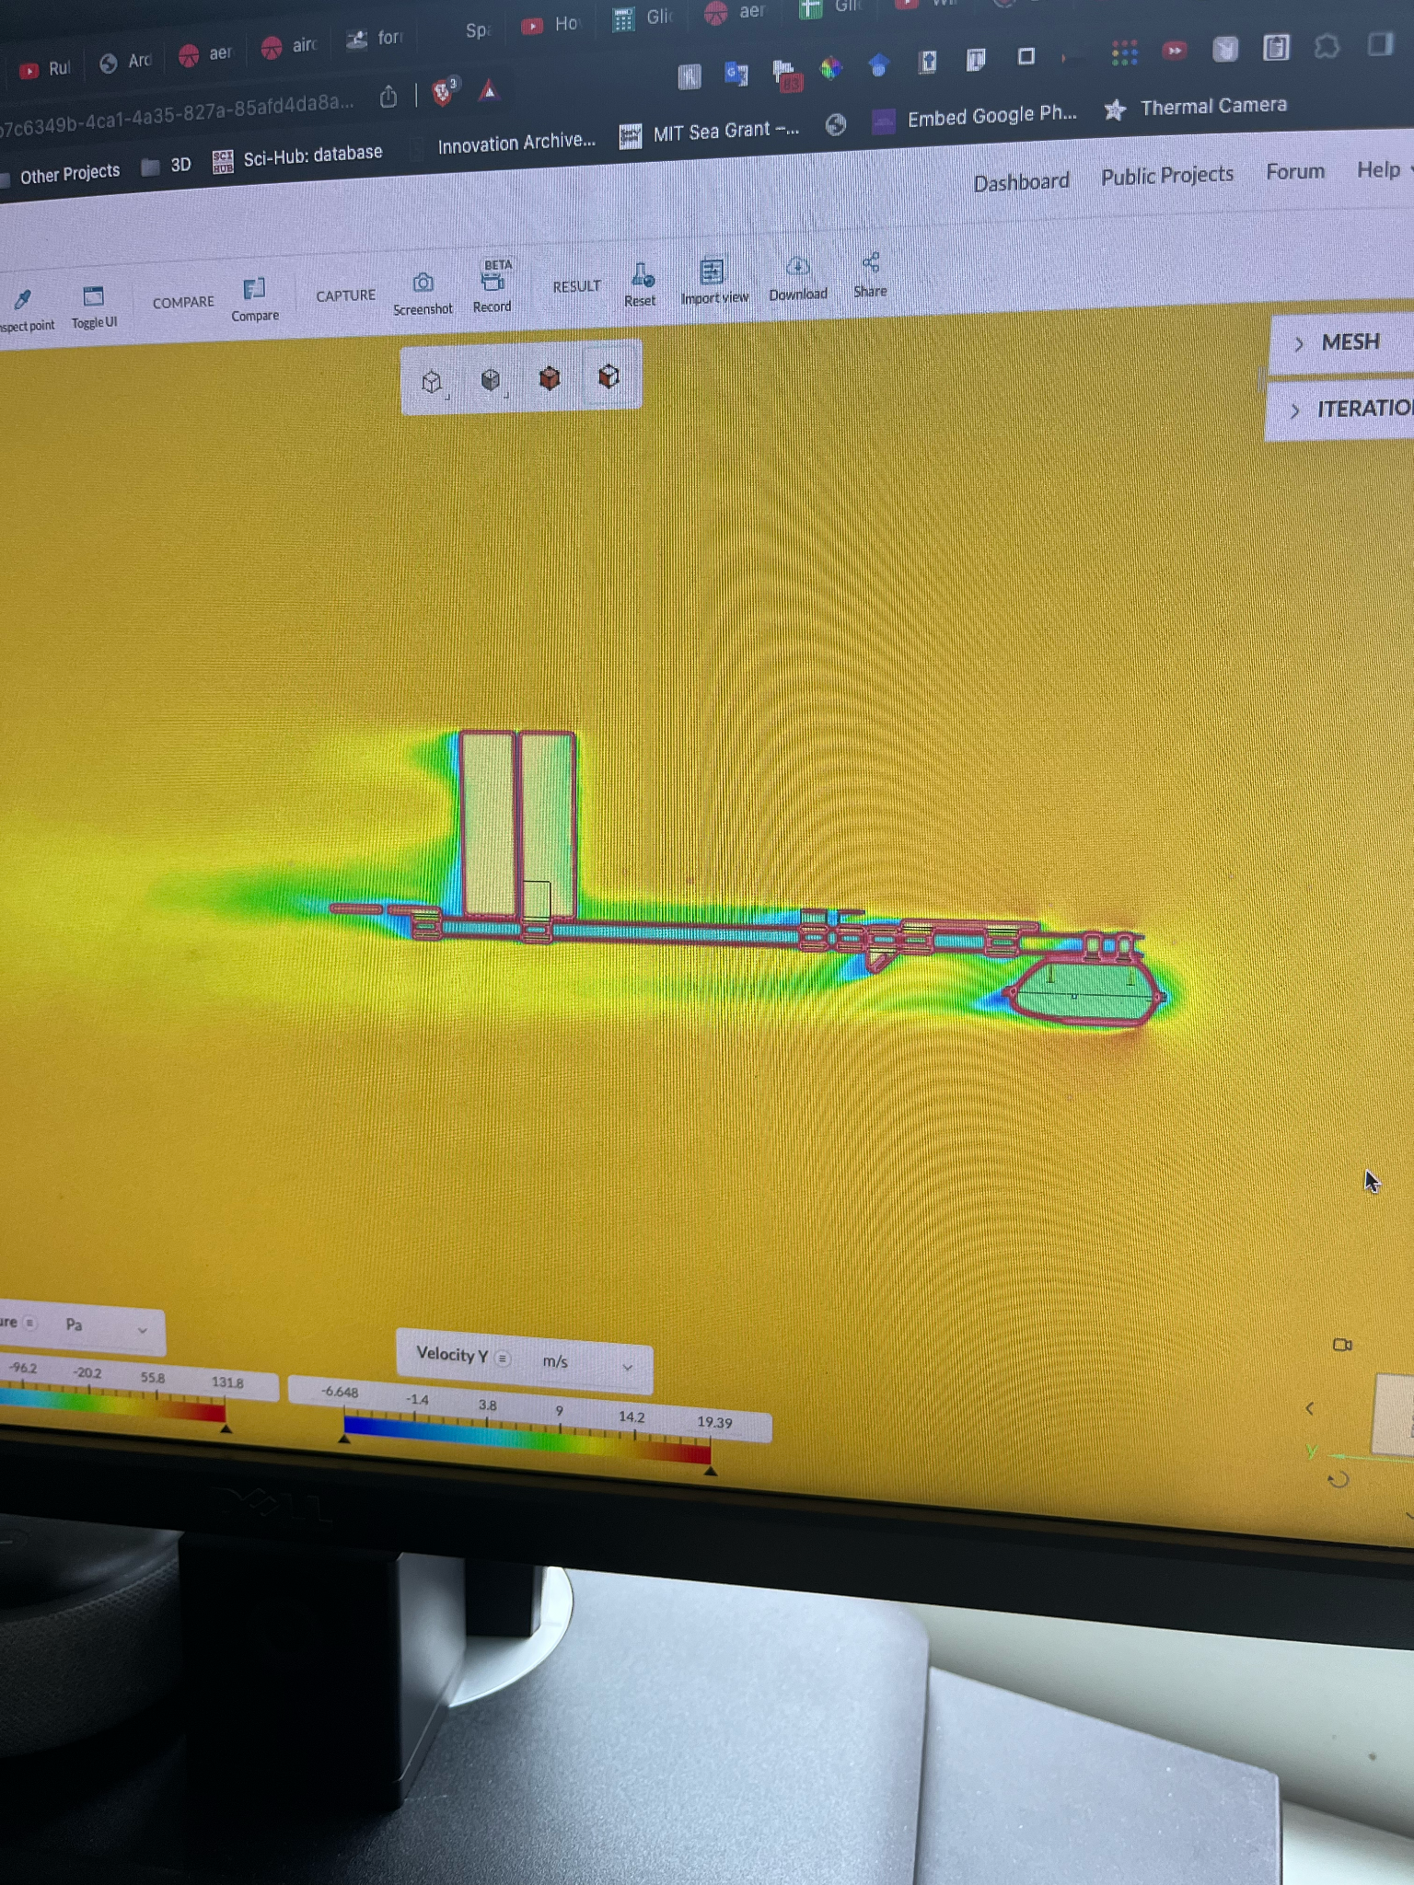

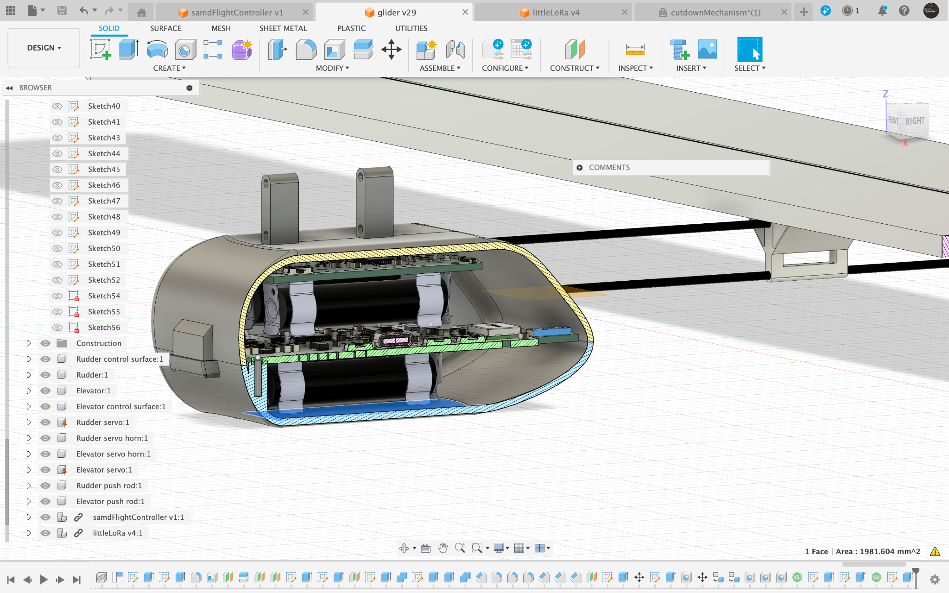
Next Steps
StratoSoar MK3
Custom flying wing glider
Custom high performance glider
Smaller electronics
Integrated tracking

Slide 11
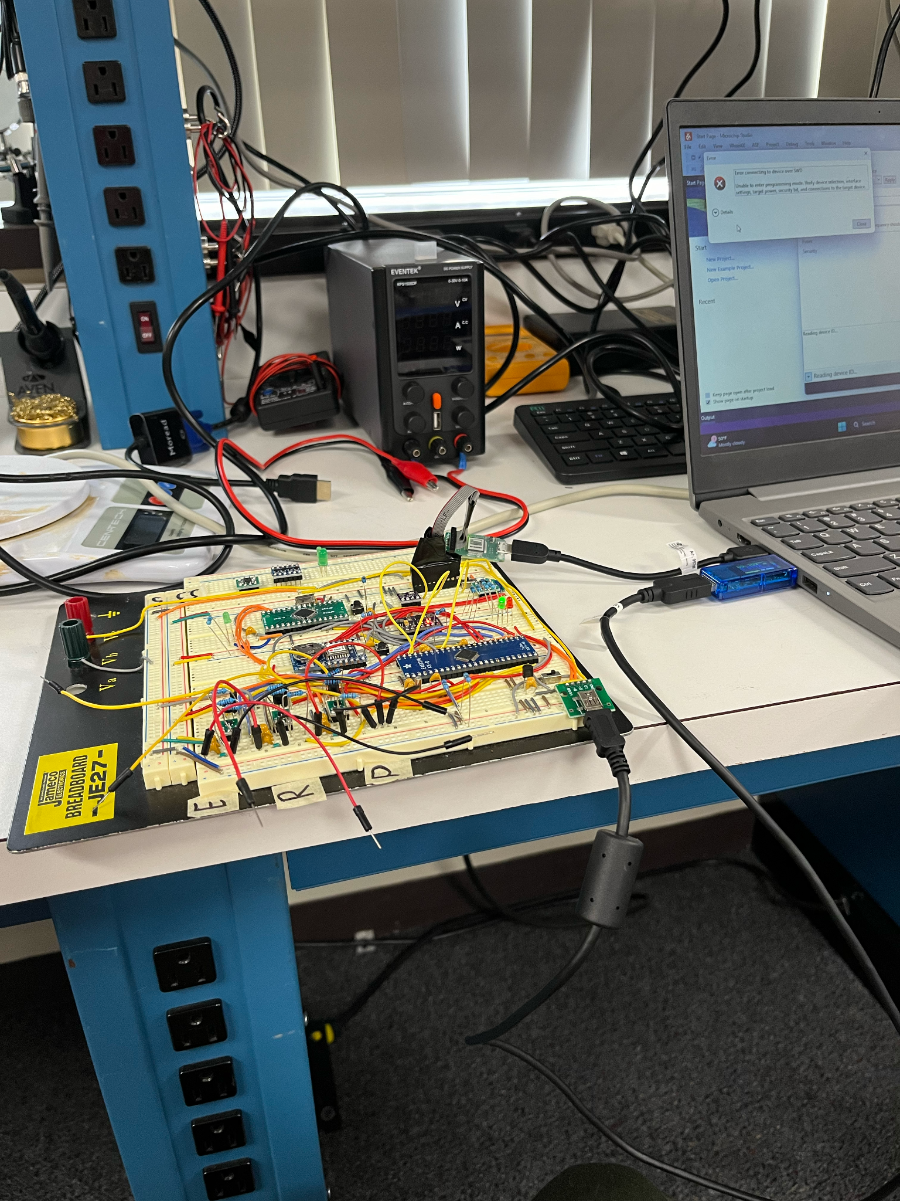
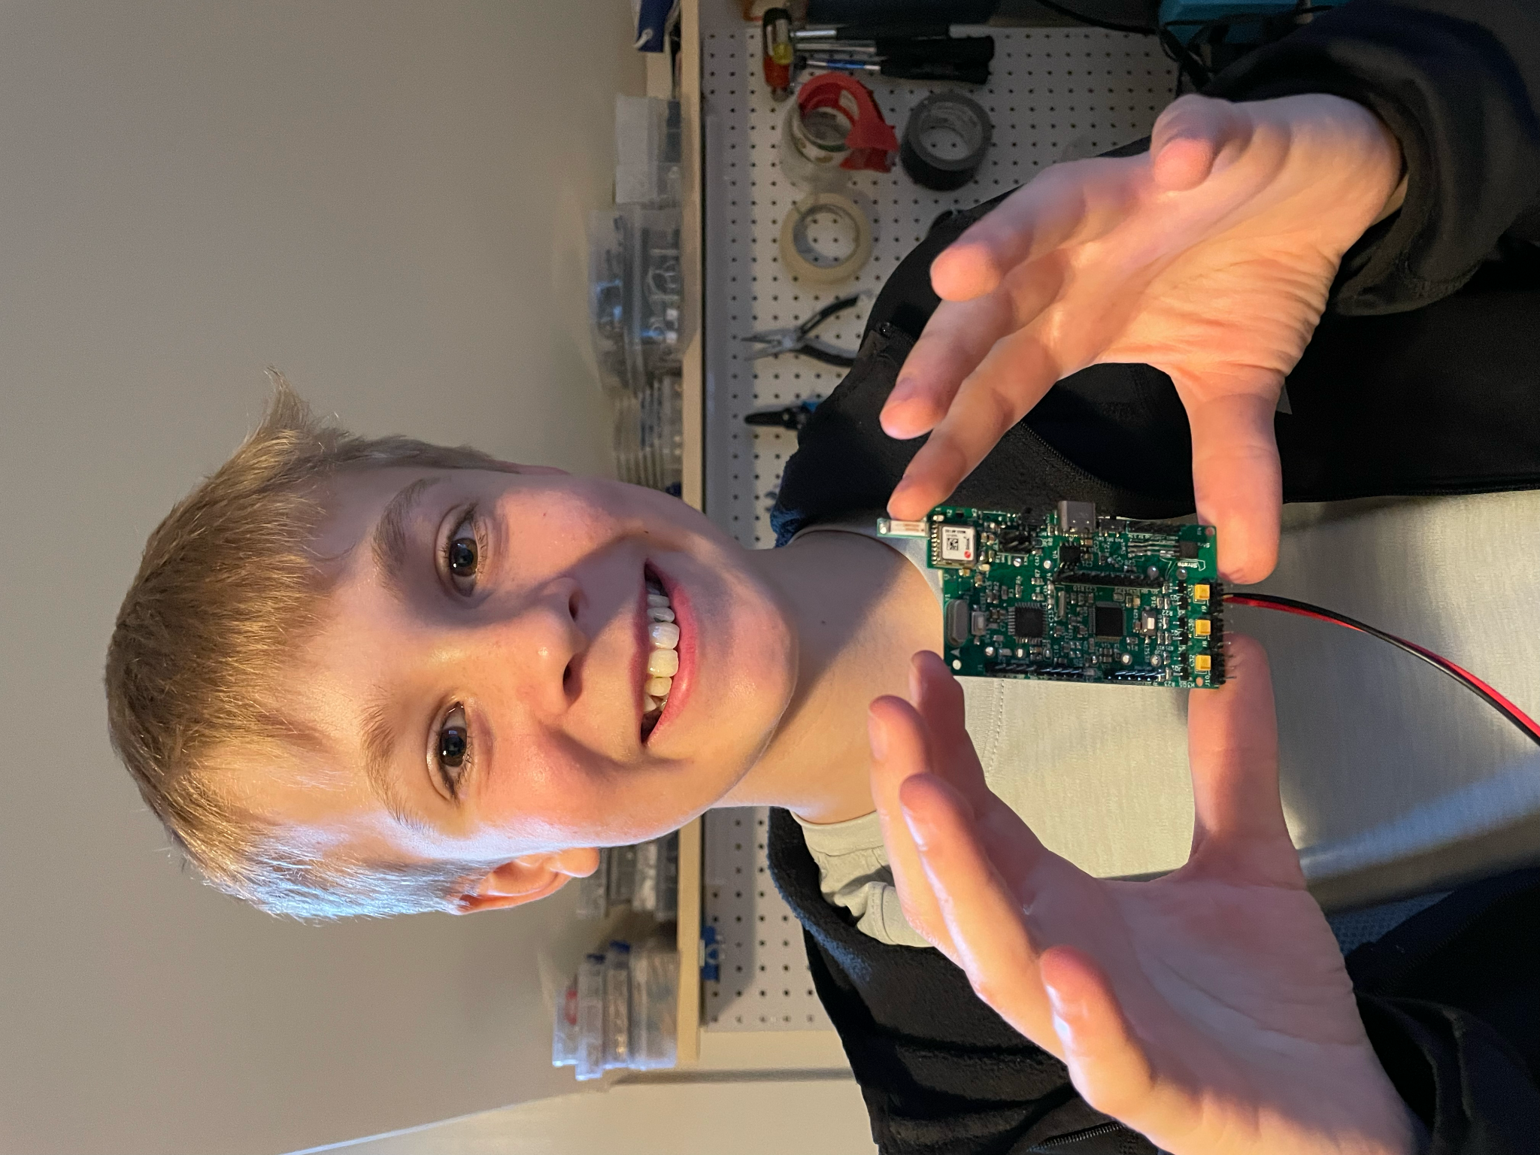
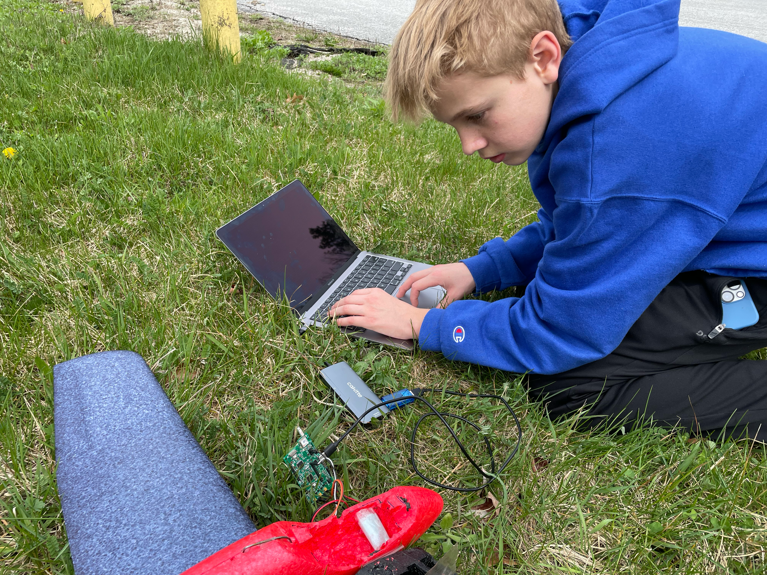
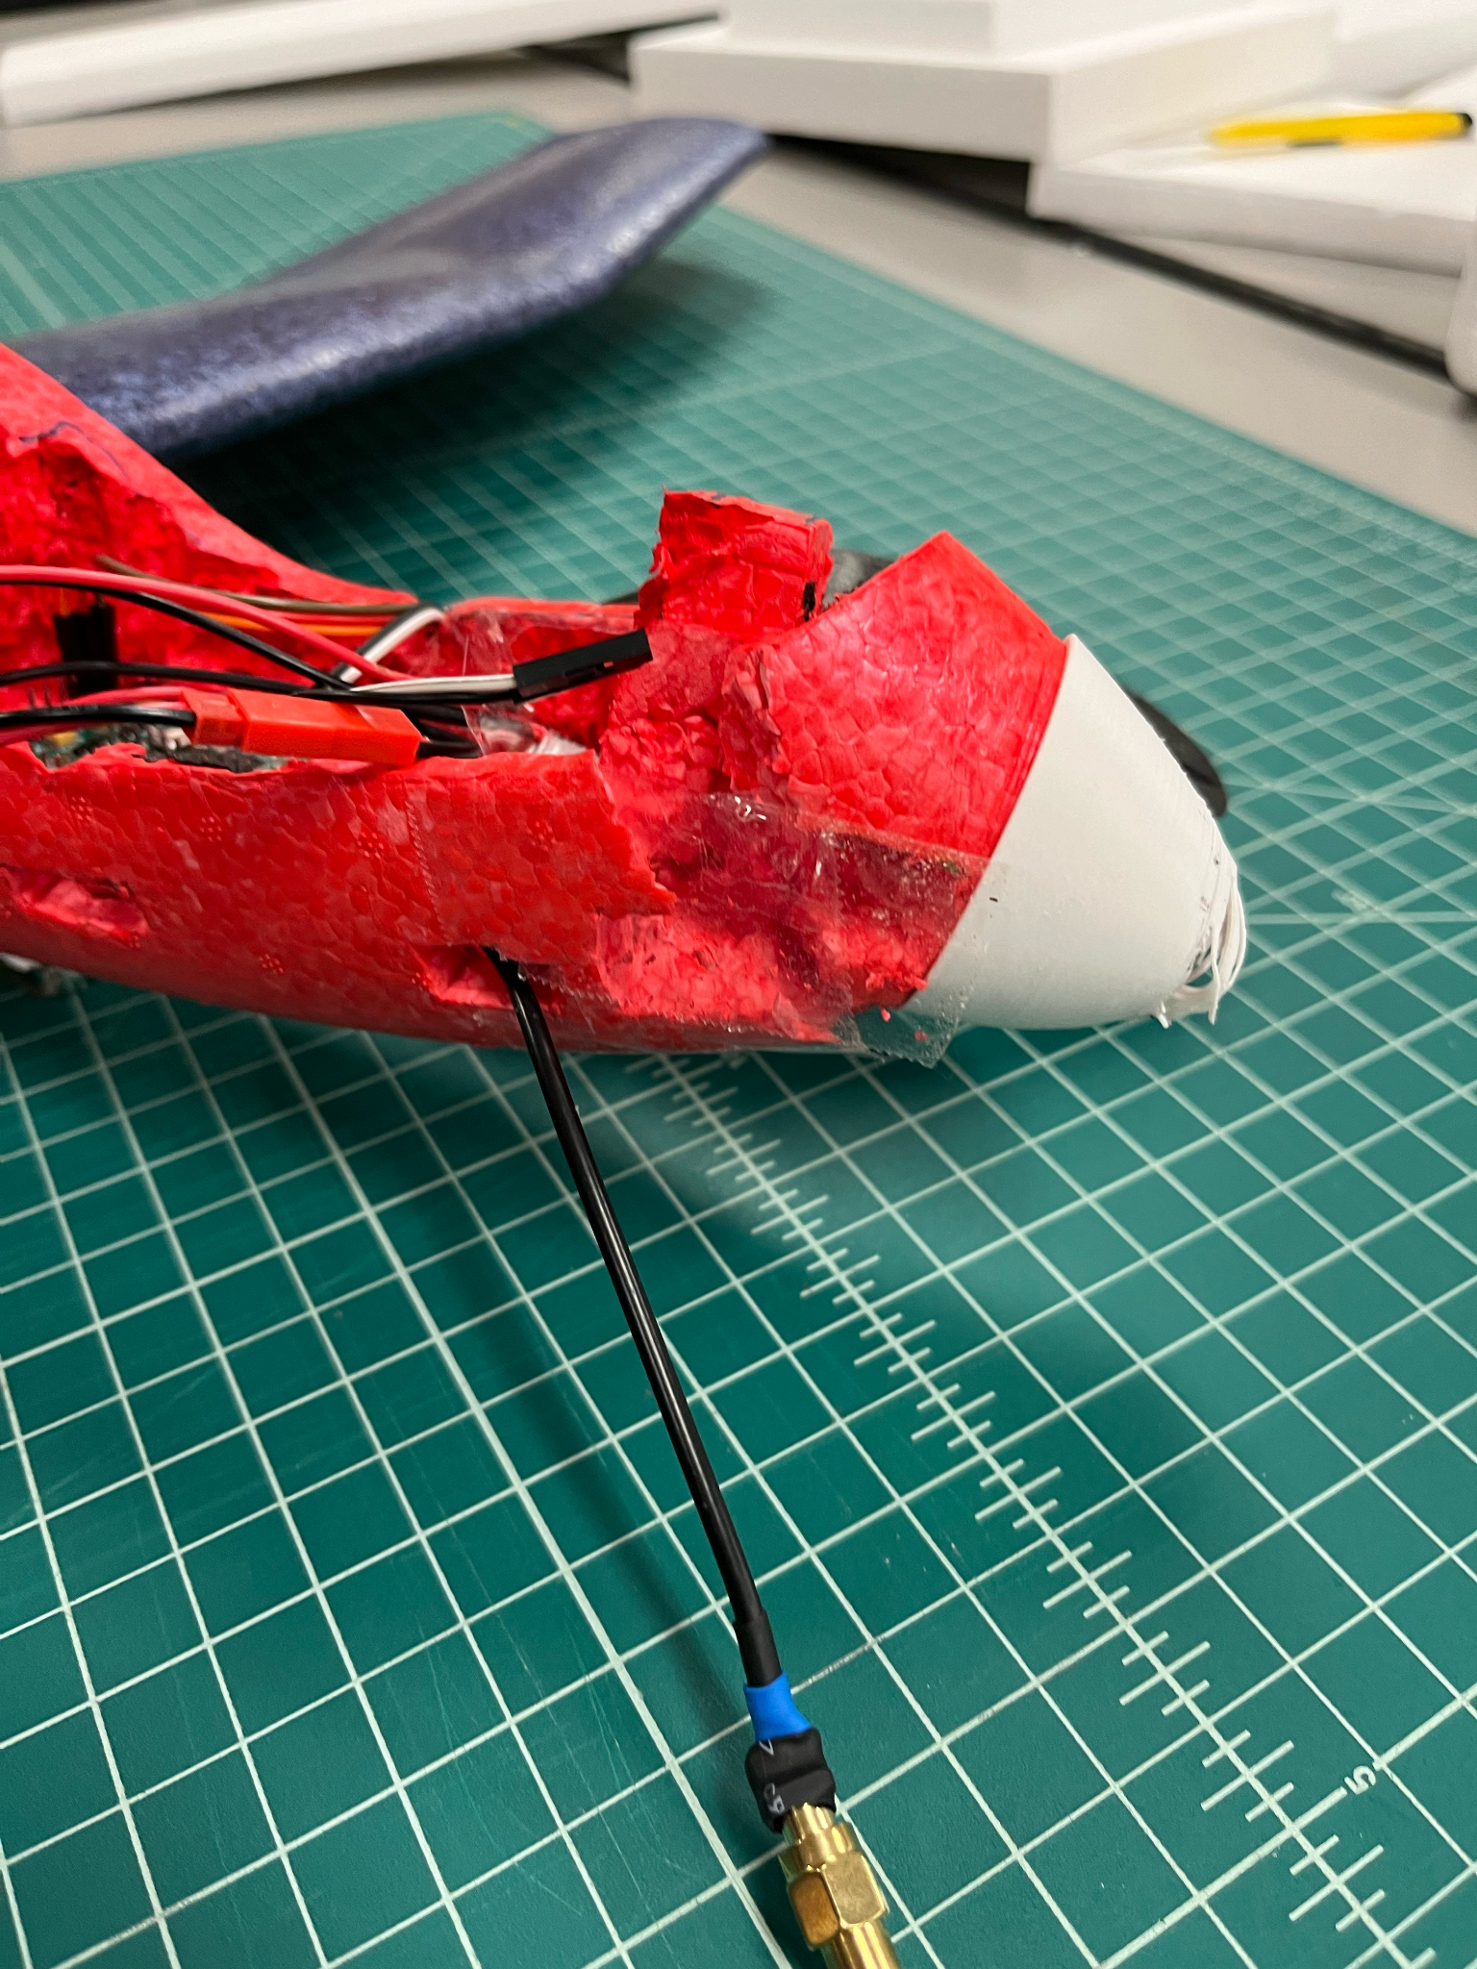
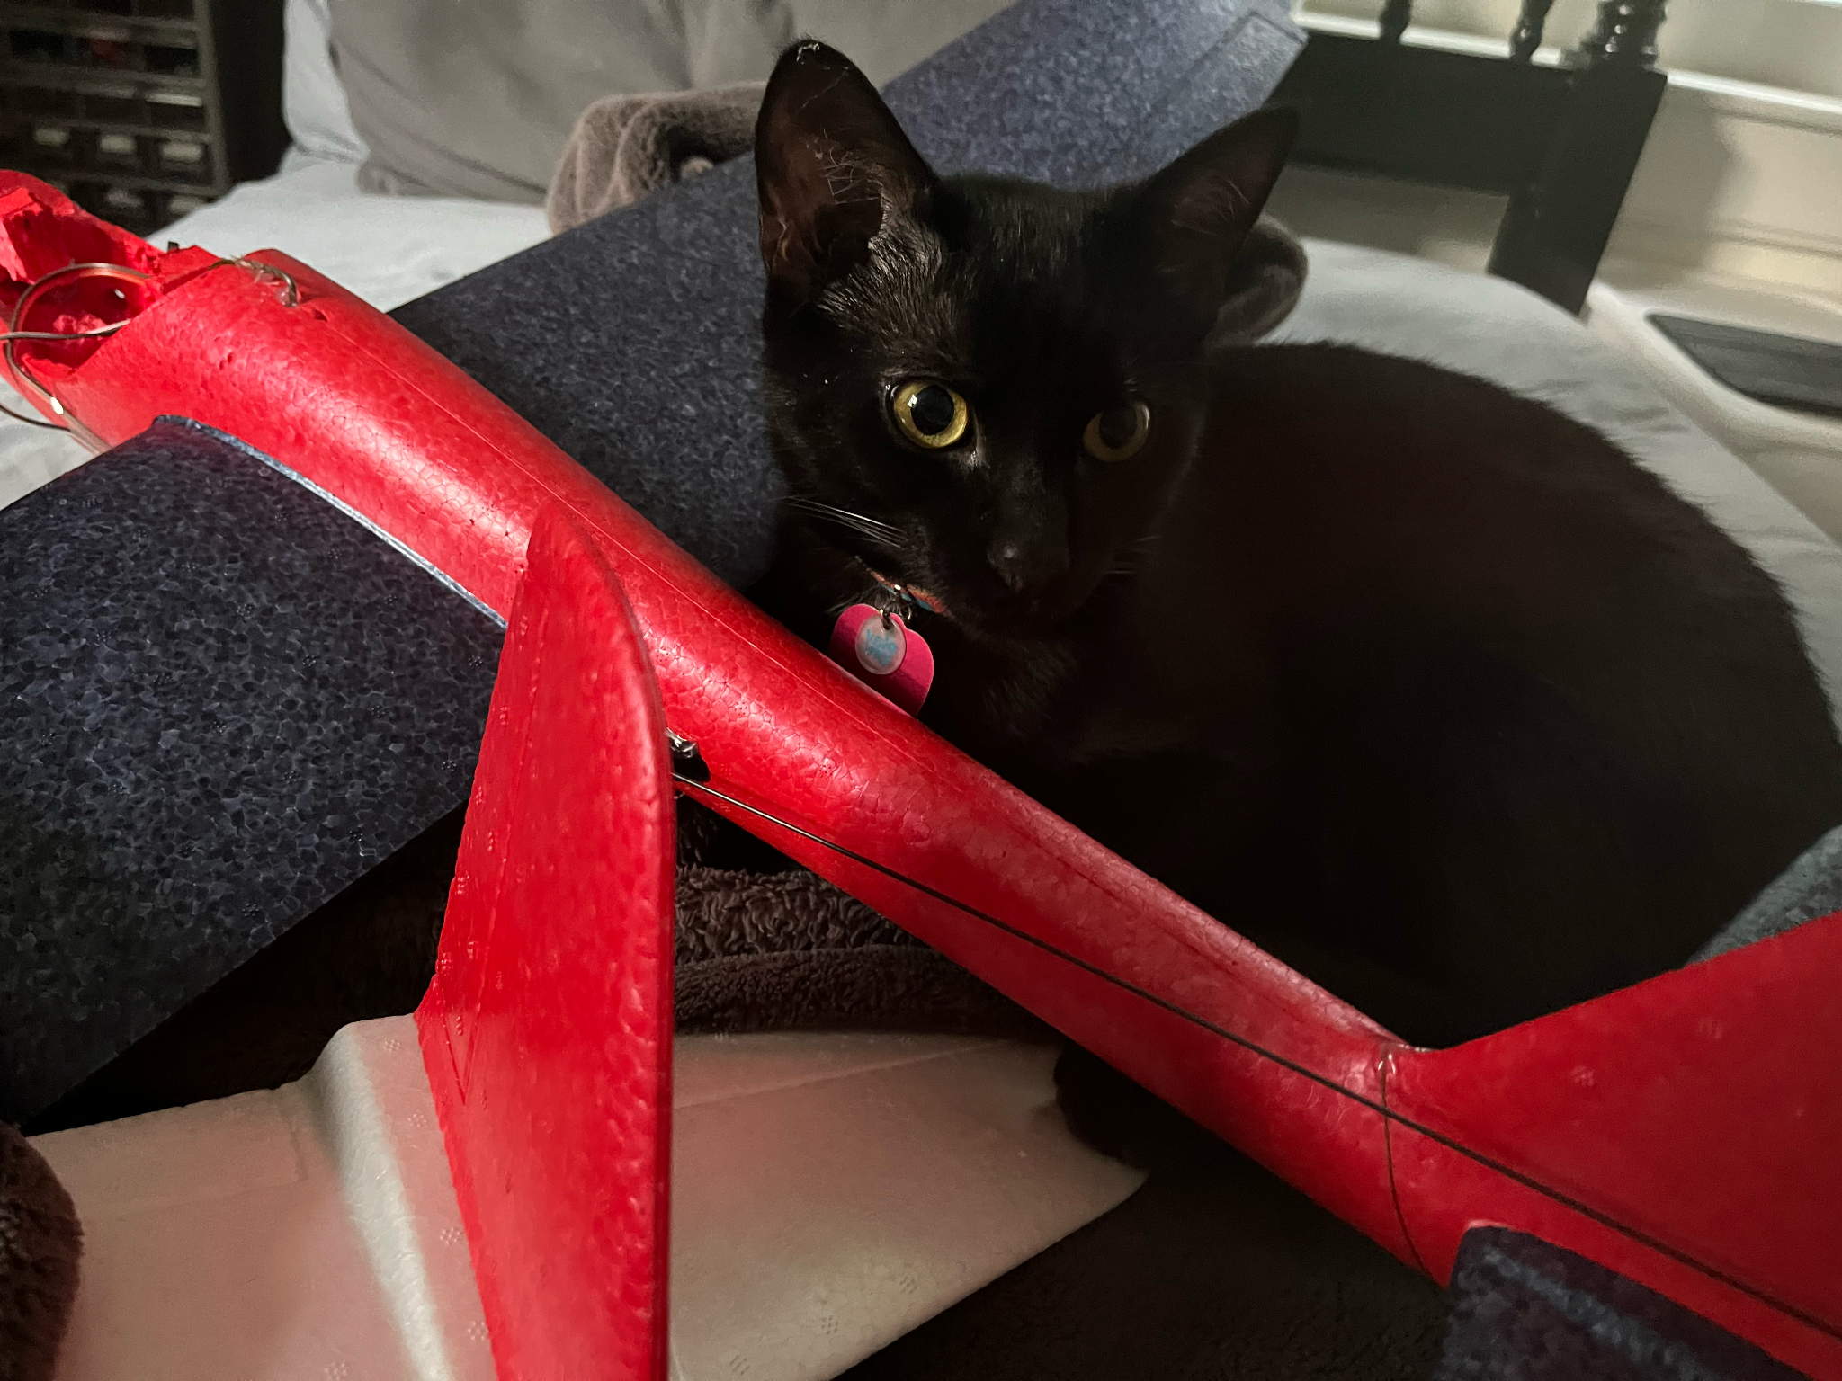
The Journey

Slide 12
Thank You for Listening!
Project page + GitHub: https://github.com/crnicholson/StratoSoar-MK2
Photos + videos: https://github.com/crnicholson/StratoSoar-MK2-Media
Email: charlienicholsonr@gmail.com

Slide 13

Legal Shmeegle
Glider is free flight glider
Loophole means little restrictions from FAA
However, tracker is not FCC approved

